Slide 1
Powerplant Project

Slide 2


Slide 3

Objective
Calculate power each of a multitude of different powerplants need to produce when the load is given and taking into account the cost of energy source.

Slide 4
Problem Statement
We can not store the electricity in a cheap way.
We need to predict the demand about electricity consumption
There are 3 types of powerplant for 3 types of energy
Gasfired (gas)
Windturbine (wind)
Turbojet (kerosine)

Slide 5
Challenge
We have to figure out the best combination of power plants to use, considering their costs and how much electricity they can produce.
We have to consider both their maximum capacity (Pmax) and this minimum amount they have to generate (Pmin)
Goal is to supply the needed electricity at the lowest cost by choosing the right combination
Establishing the merit order, a crucial factor in determining the activation sequence of power plants and the corresponding power output

Slide 6
Solution
1
This sequence is determined based on the cost of fuels associated with each power plant.
2
The selection process relies on the cost of energy production from these power plants.
3
Generate multiple path options
choose the path with the lowest cost for our electricity production
Uniform cost search algorithm
Decisions on which power plants to activate and the quantity of power they will generate.

Slide 7
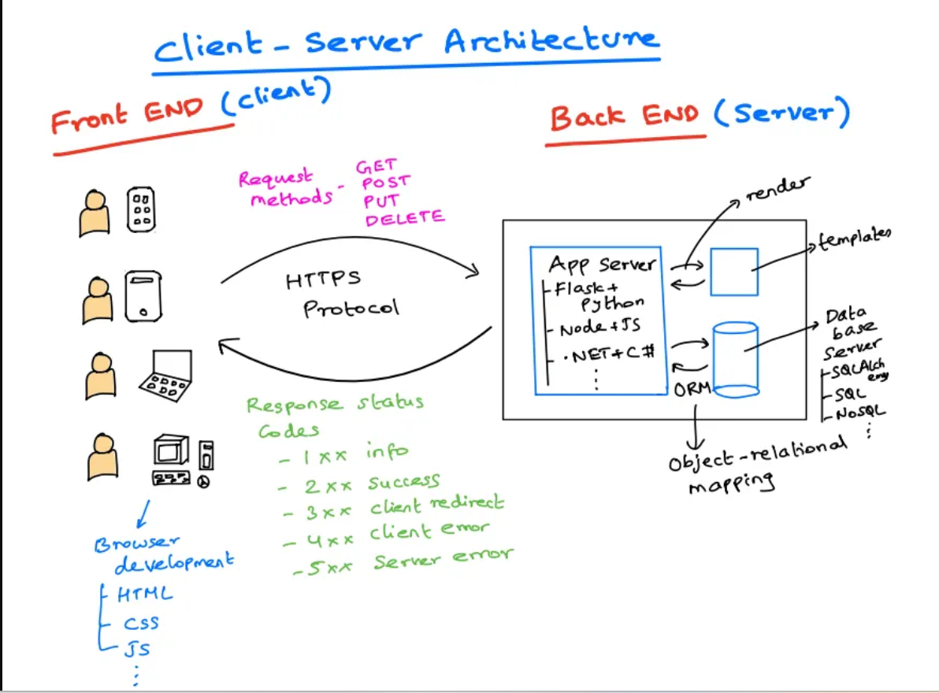
Client-Server Model

Slide 8
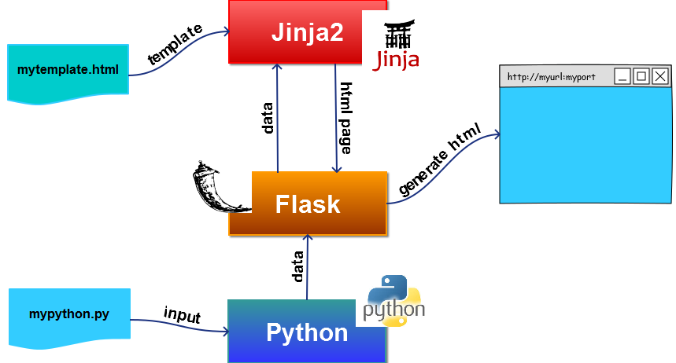
Flask Architecture

Slide 9
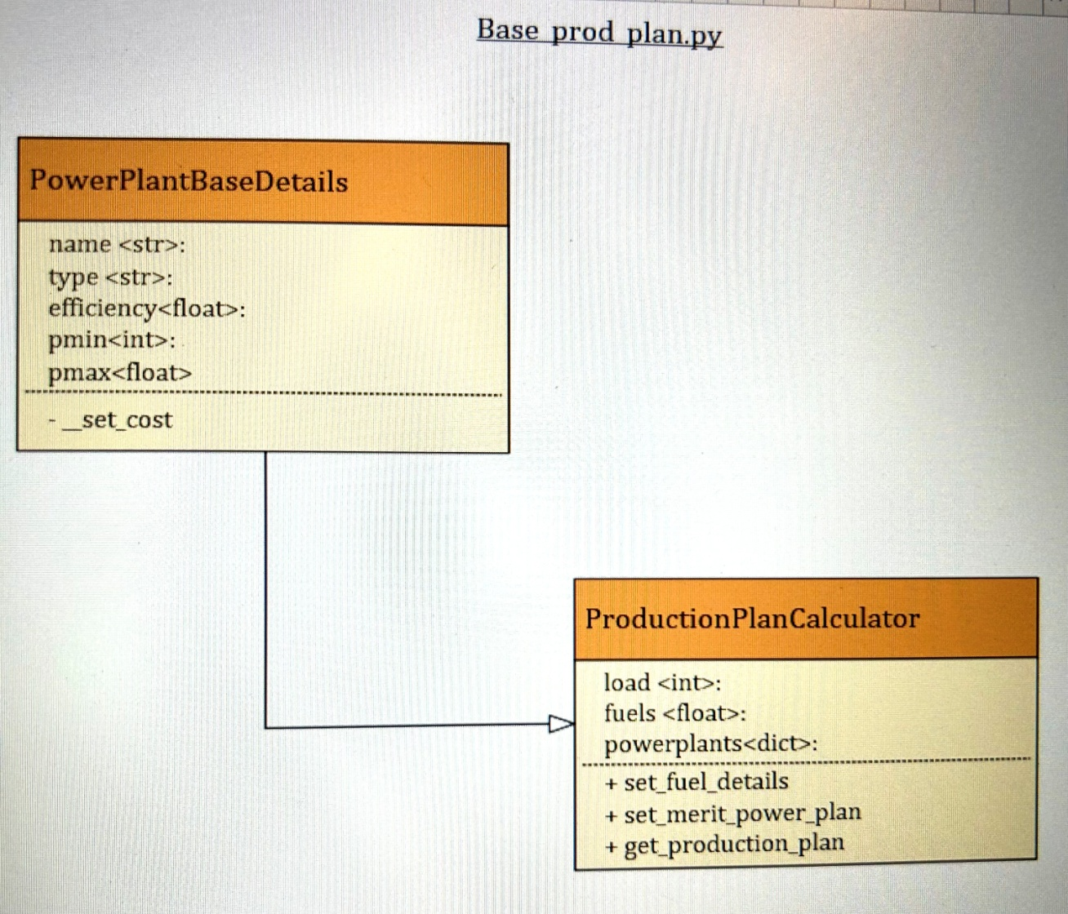
Class Diagram

Slide 10
DEMO
Code WalkThrough

Slide 11
Thank You

